Slide 1
Data Structures
Queues
Dr. Wedad Hussein
Information Systems Department
wedad.hussein@cis.asu.edu.eg
Dr. Hanan Yousry
Computer Science Department
hanan.hindy@cis.asu.edu.eg

Slide 2
Course Contents
Pointers revision + Introduction to Classes.
Stacks
Queues
Array Lists
Linked Lists
Binary Search Trees
Hash Tables
STL
Graphs

Slide 3
Templates

Slide 4
Problem?
Some algorithms are type independent (the logic does not depend on the data type of items processed).
It’s preferable to write the code once rather than recode it for each different type.
Achieved by using Templates:
Function Templates.
Class Templates.

Slide 5
Function Templates
A function template is not an actual function, but instead is a pattern for what could become a function.
template <typename T>
T maximum(T x, T y)
{
if (x < y)
return y;
else
return x;
}

Slide 6

Function Templates
cout<<maximum(3,1)<<endl;
cout<<maximum(2.3,5.1)<<endl;
cout<<maximum('a','d')<<endl;

Slide 7
Class Templates
Class templates are often used to make generic containers.
template <class N>
class rectangle
{
private:
N width;
N height;
public:
rectangle(N, N);
rectangle();
N area();
~rectangle(void);
};

Slide 8
Class Templates cont.
Member Functions:
template <class N>
N rectangle<N>::area()
{
return width*height;
}
Declaring Objects:
rectangle<float> r1(5.3,7.0);
rectangle<int> r1(5,7);

Slide 9

Queues

Slide 10
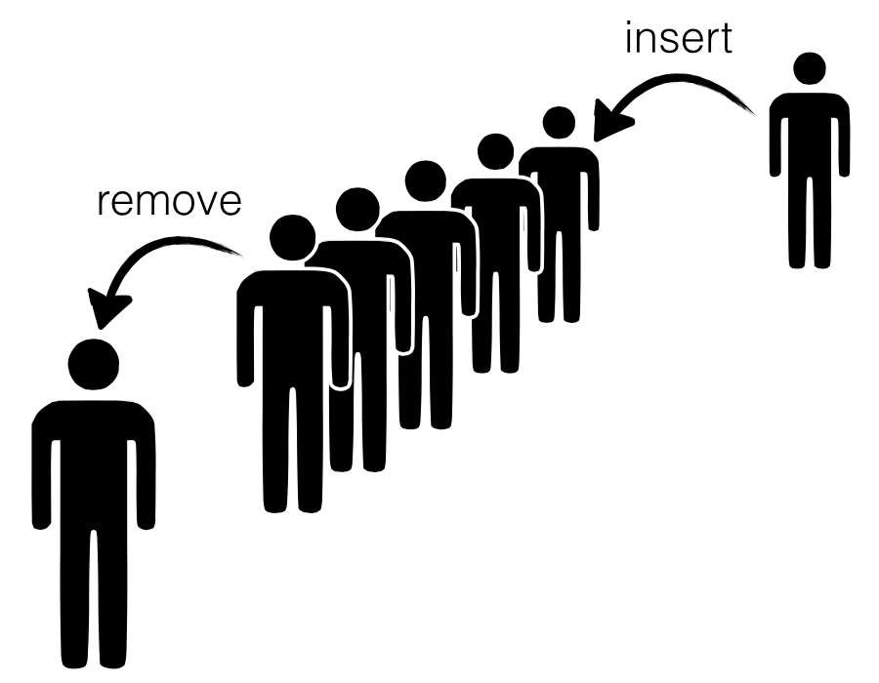
Queues

Slide 11
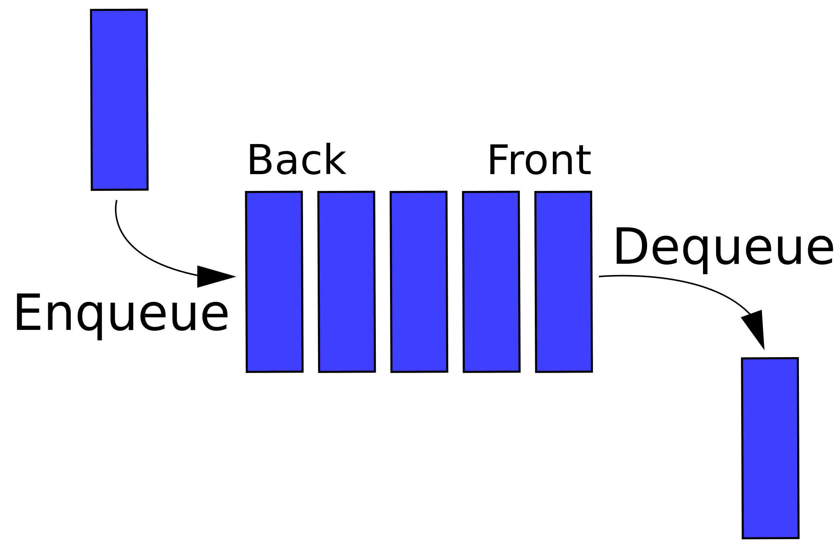
The Queue ADT
Like stacks, queues are lists. With a queue, however, insertion is done at one end whereas deletion is performed at the other end. (FIFO).

Slide 12
Applications
Job Scheduling: e.g. When jobs are submitted to a printer, they are arranged in order of arrival.
Call center customer calls.
Queuing theory:
deals with computing, probabilistically, how long users expect to wait on a line, how long the line gets, and other such questions.
The answer depends on how frequently users arrive to the line and how long it takes to process a user once the user is served.

Slide 13
Operations
Length: Returns the number of elements.
Enqueue: Adds an element to the end of the queue.
Dequeue: Removes the element at the front of the queue.
Front: Returns the front element.
Empty: Returns whether the queue is empty.

Slide 14

Implementation

Slide 15
Queue ADT Implementations
Using Linked Lists:
Front
Back
9
8
7
Using Dynamic Arrays:
Front
Back
 |  | 5 | 6 | 7 | 8 | 9

Slide 16
Array Implementation of Queues
After a few insertions and deletions
Front
Back
 |  | 7 | 6 | 5 | 4 | 3

Slide 17
Array Implementation of Queues
This could give and illusion of a full queue.
Front
Back
9 | 8 | 7 | 6 | 5 | 4

Slide 18
Circular Array Implementation
Enqueue(10)
Back
Front
9 | 8 | 7 | 6 | 5 | 4 |  |  | 10

Slide 19
Circular Array Implementation
Enqueue(11)
Back
Front
9 | 8 | 7 | 6 | 5 | 4 |  | 11 | 10

Slide 20
Circular Array Implementation
Dequeue()
Back
Front
9 | 8 | 7 | 6 | 5 |  |  | 11 | 10

Slide 21
Operations
Length: Returns the number of elements.
Enqueue: Adds an element to the end of the queue.
Dequeue: Removes the element at the front of the queue.
Front: Returns the front element.
Empty: Returns whether the queue is empty.

Slide 22
Queue STL

Slide 23
Queue STL
queue<T>
Operations:
empty
pop (= dequeue)
Push (= enqueue)
size
front
back

Slide 24
deque STL
deque<T>
Stands for: double ended queue
Operations:
empty
pop_back (remove last element)
pop_front (remove first element) (=dequeue)
push_back (= enqueue)
push_front (adds an element at the start)
size
front
back

Slide 25
Lecture Resources
Lecture Notes.
Lecture Code.
Text Book:
Chapter 1: 1.6
Chapter 3: 3.7.
Useful Links:
Queue Problem: https://uva.onlinejudge.org/index.php?option=onlinejudge&page=show_problem&problem=1876

Slide 26
Thank You

